Slide 1
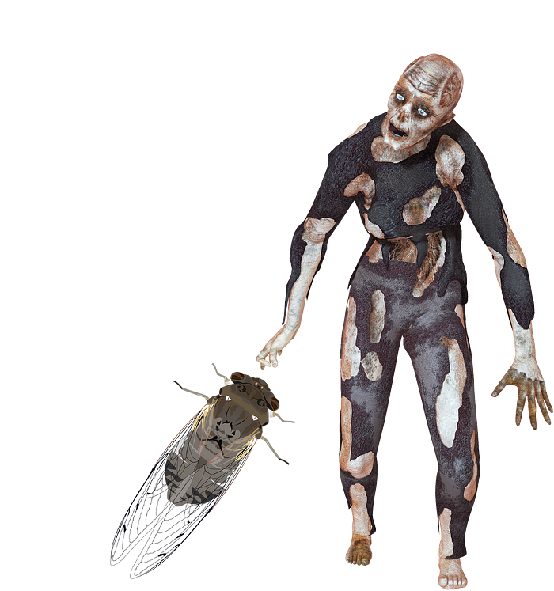
Cicada “Zombies”
Field: Entomology / Biology / Others
Research Questions:
Based on image recognition, can we accurately predict the Cicada has the disease?
Other possible research questions (if time permits)
Can we accurately identify if a Cicada has a fungus called Massospora cicadina, which causes negative implications to the Cicada population based on multiple data features?
How do bioclimatic variables influence infection rates?
How does climate change and warmer soil temperatures impact the timing of emergence?
Data Status: Investigating data from the National Library of Medicine, GenBank, Zenodo, DDBJ, ENA, NASA LIS, NOAA, iNaturalist, Others
Context: This spring, two broods of periodical cicadas (among seven) will emerge in parts of the South and the Midwest singing their love songs. The co-emergence of these two broods has not happened since Thomas Jefferson was president. Like many animals, they, too, are susceptible to diseases. And one of those diseases they get is a fungal infection by a fungus called Massospora cicadina where a third of the body has been replaced with fungal tissue. This causes something called active host transmission causing erratic mating behavior spreading the disease (basically making other Cicada "Zombies"). Also, a possible factor is the impact of climate change since broods emerge at specific soil temperatures and this year is predicted to be the hottest year on record.

Slide 2

Initial Project Scope & Timeline

